Slide 1
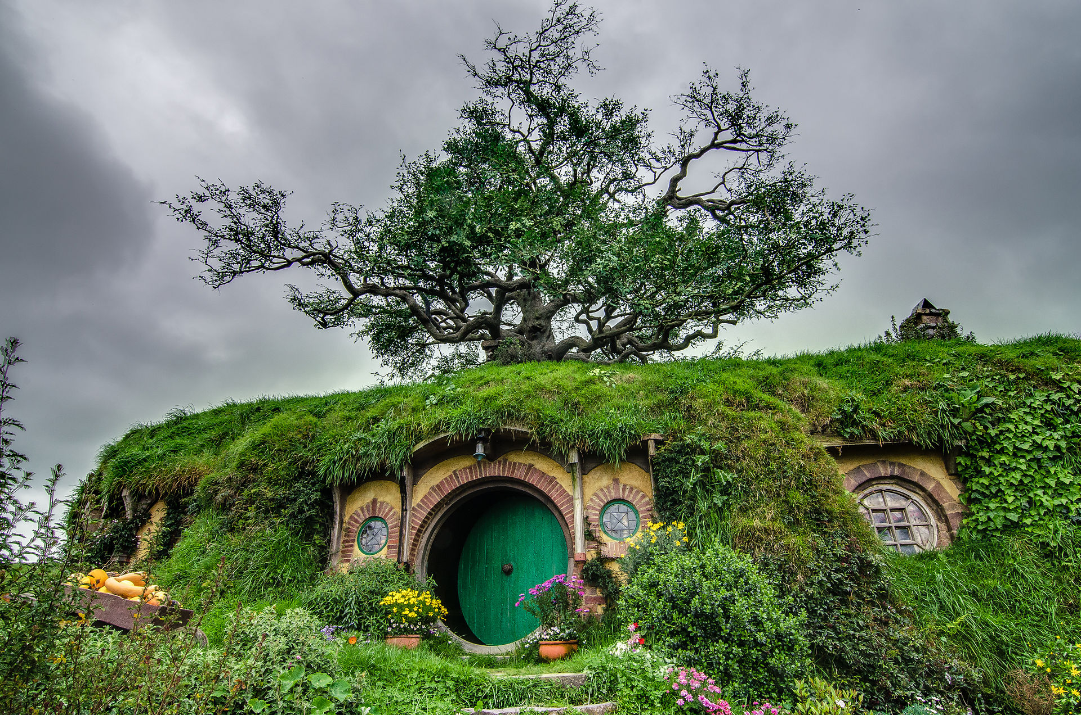
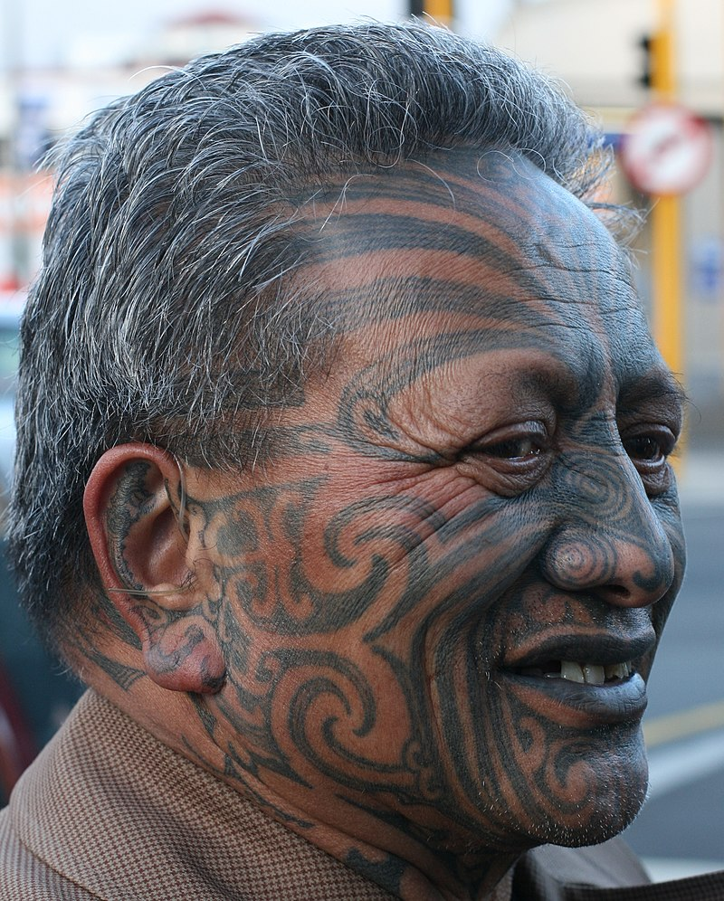
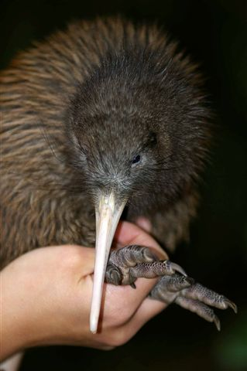

Slide 2
New Zealand?
Share your own thoughts and experiences of New Zealand!
(Is there anything you know about New Zealand that you want to share?)
Name one thing that you would like to know about New Zealand!
vs.

Slide 4
While watching, think about the following question:
What are the two main topics that the National Geographics team reflects upon?

Slide 6
https://www.youtube.com/watch?v=1Evj5XMTWEo

Slide 7
Image Sources:
Hobbington by Tom Hall - https://www.flickr.com/photos/tom_hall_nz/15189132237/
https://upload.wikimedia.org/wikipedia/commons/b/bd/Karuwai_at_August_2005_Health_Check.JPG
https://en.wikipedia.org/wiki/T%C4%81_moko#/media/File:Tame_Iti_at_gallery_opening_13_October_2009.jpg
Australian Flag: https://commons.wikimedia.org/wiki/File:Flag_of_Australia.svg

